Slide 1



Improving the Effectiveness of Substance Use Disorder Treatment
Erick Guerrero, Ph.D.
Associate Professor
USC Suzanne Dworak-Peck School of Social Work
USC Marshall School of Business
University of Southern California
NIDA R33-DA035634
NIDA R33-DA035634-S
NIDA R01 DA038608
CTSI- 3420989
Public Policy Exchange
Los Angeles, CA
February 20th, 2018
1

Slide 2
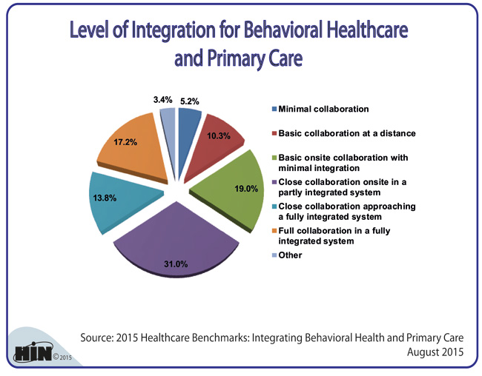

Study 1 – Implementation of Integration of CARe Practices

Slide 3
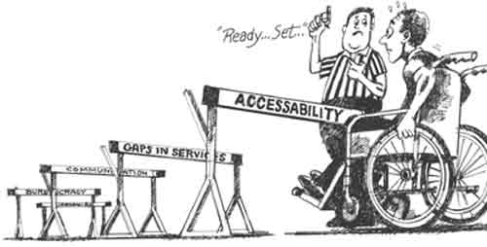
SOCIAL PROBLEM
Addiction health services (AHS) programs face many barriers to effective integration with primary care and other health and behavioral health services (Guerrero, Aarons, & Palinkas, 2014; McLellan & Woodworth, 2014 ).
More than 40% of individuals seeking substance use disorder (SUD) treatment also report a mental health or physical health disorder. Yet, integrated care is limited in SUD treatment programs (McLellan & Woodworth, 2014, Molfenter, 2014 ).
Notes:
(basic coordination among service providers residing in separate locations and colocation of services in a single facility to service integration).
This study focused on contextual factors associated with implementation of high coordination of mental health and public health services in AHS programs serving low-income racial and ethnic minority communities in Los Angeles, CA, between 2011 and 2013.

Slide 4
Explained by resource dependency (Pfeffer & Salancik, 1978) and organizational development (leadership and readiness for change) frameworks (Edwards, Knight, Broome, & Flynn, 2010; Simpson & Flynn, 2007, we posit the following hypotheses:
Hypothesis 1: Outer context factors such as public funding and receipt of licensure and professional accreditation would be associated with higher odds of implementing coordination with mental health and public health services.
Hypothesis 2: Inner context factors, such as leadership, readiness for change and cultural competence would be associated with increased odds of implementing coordination with mental health and public health services.

Slide 5
ANALYTICAL FRAMEWORK
OUTER CONTEXT:
- Public funding
- Licensed
- Accredited (TJC)
COORDINATION WITH MENTAL HEALTH PROVIDERS
INNER CONTEXT:
- Leadership
- Readiness for Change
- Cultural Competence
COORDINATION WITH PUBLIC HEALTH PROVIDERS
- Medicaid Acceptance
- Parent Organization
Notes:
5

Slide 6

Independent Variables
Public funding (%), and whether program has state licensure and The Joint Commission (TJC) accreditation.
Leadership
– Two subscales: Transformational (seven items, α = .92) and Transactional (two items, α = .77) leadership (Edwards, Knight, Broome, & Flynn, 2010).
Organizational readiness for change
– Texas Christian University measure – 6 scales, α > .89 (Simpson & Flynn. 2007).
Medi-Cal payment acceptance
– Program has a billing system for Medicaid billing and reporting.
Organizational cultural competence – 6 subscales, 57 items. (Mason, 1995).

Slide 7
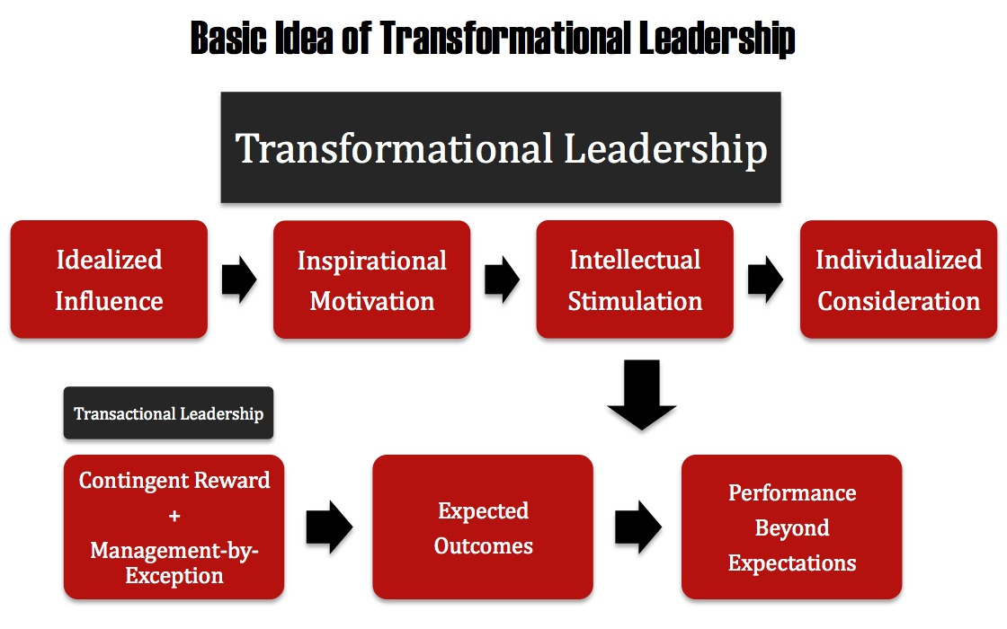
Notes:
Leadership is an emerging focal point in efforts to increase the uptake of evidence-based practices and improve the quality of care in behavioral health.^{1, 21}
Transactional orientation (guiding performance) and transformational approach (leading by example and motivating self-growth) have been essential components of leadership associated with staff satisfaction, a critical aspect of the implementation process.^{1,15}
Hypothesis 1. Licensure would be positively associated with COD treatment process and supervision and training.
Hypothesis 2. Directorial leadership would be positively associated with COD treatment process and supervision and training.
Qualitative focus groups will complement the quantitative findings – mixed methods approach followed a “complementary approach” qualitative complemented quantitative findings.

Slide 8
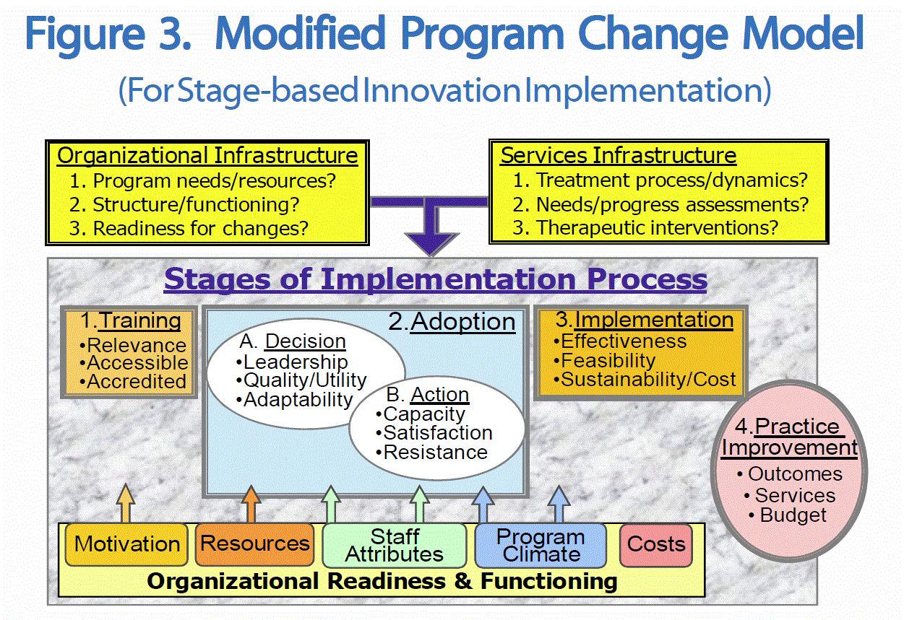
Notes:
8
Matching comprehensive services to needs is a useful addiction treatment practice, especially for high-need patients (Friedmann et al., 2004)

Slide 9
Organizational Cultural Competence
Variables | M (SD), %, or n | Response Format
Program Characteristics
Cultural Competenceª |  | 57 Items, Likert Scale- 1-low, 4-High multiplied by 10.
Knowledge of communities | 28.23 (6.69) | 9 items, e.g., How well can you describe Latino social problems in your service area?
Personal involvement | 24.08 (8.53) | 3 items, e.g., How much do you interact with ethnic minority communities in your service area?
Resources and linkages | 29.15 (4.94) | 15 items, e.g., Do you collaborate with programs that provide mental health psychiatric services?
Staff diversity | 26.99 (4.98) | 12 items, e.g., Does your agency staff represent the racial/ethnic backgrounds of your clients?
Reaching out to communities | 28.94 (5.32) | 8 items, e.g., Does your agency reach out to residents and organizations in communities of color?
Policies and procedures | 24.56 (5.80) | 10 items, e.g., Does your agency use race/ethnic-specific assessment instructions for diagnosis?

Slide 10
Data was collected from publicly funded SAT programs.
- Sample was drawn from service areas covering more than 7 million residents
(L.A. County).
Baseline data
- Sampling frame included 408 programs that were randomly sampled from 350
programs (Communities with more than 40% African American and Latino residents).
- Analytic sample consisted of 112 programs at Time 1 (T1) and 122 programs at Time 2 (T2), with 61 programs included in both periods of data collection.
- Survey data provided by two managers and three counselors from each program. Multilevel regression models applied
- Interview data provided by a manager (30 interviews) coded and analyzed by team.
METHODS | 7

Slide 11
RESULTS
Guerrero, E. G., Andrews, C., Harris, L., Padwa, H., Kong, Y., & Fenwick, K. (2016). Improving coordination of addiction health services organizations with mental health and public health services. Journal of substance abuse treatment, 60, 45-53.

Slide 12
ANALYTICAL FRAMEWORK
OUTER CONTEXT:
- Public funding
- Licensed
- Accredited (TJC)
COORDINATION WITH MENTAL HEALTH PROVIDERS
INNER CONTEXT:
- Cultural Competence
(Knowledge) (+)
COORDINATION WITH PUBLIC HEALTH PROVIDERS
- Cultural Competence
(Resources & Linkages) (+)
Notes:
12

Slide 13
Notes:
Qualitative analysis highlighted the role of leadership in leveraging funding and developing creative solutions to deliver coordinated care.

Slide 14

Study 2: The ROLE of integrated care TO IMPROVE TREATMENT EFFECTIVENESS
Notes:
Two waves of program and client level data:
- 11,533 clients (primarily African American and Latino)
data collected during personal interviews with clients at admission/discharge
106 treatment programs in minority communities collected from program supervisors via electronic survey.
Data validation using site visits and counselor interview.

Slide 15
IMPLEMENTATION
CAPACITY
CLIENT OUTCOMES
Mental Health Coordination
Leadership
Wait- Time
Public Health Coordination
Integrated Care
Readiness for Change
Program Capacity
Retention
Expansion of Public Health Insurance
Public Health Insurance
Billing Capacity
HIV Prevention Svcs
Professionalism
Policy Level
Organizational Level
Service Delivery Level
Client Level
Notes:
Tenie: Please make model bigger to properly show in a slide.

Slide 16
COORDINATED CARE AND CLIENT OUTCOMES
High program capacity and delivery of mental health services eliminate disparities
Direct: -1.821; p < .01
Direct: -1.334; p < .01
Indirect: -0.259; p < .01
Mental health coordination
Program Capacity
Wait time
Indirect: -0.016; p =.01
Receipt of HIV testing services
Direct: 0.024; p =.05
Retention
Direct: 0.024; p = .05
Guerrero, E. G., Fenwick, K., Kong, Y., Grella, C., & D’Aunno, T. (2015). Paths to improving engagement among racial and ethnic minorities in addiction health services. Substance abuse treatment, prevention, and policy, 10(1), 1.
Notes:
Study II – tested MHS on client outcomes. High program capacity, through high coordination of MHS reduces wait time.

Slide 17
IMPLICATIONS FOR PRACTICE
To develop capacity to implement evidence-based practices, it is critical to evaluate key organizational factors (leadership, funding, readiness for change).
1) Programs need to engage with their local community to improve provider networking, better assess client service needs including integrated care coordination.
2) Program leaders would benefit from training on leadership styles (transformational), as well as approaches (communicate consistent priorities) to motivate and guide staff during the implementation process.
3) The field needs to highlight key leadership strategies to support the uptake of new practices in addiction health services. This has implications for human resources, funding, technology and training.
4) County administrators need to support training and infrastructure development for billing for SA and MH services, leadership development, fidelity assessment and patient-centered measures.

Slide 18
NEXT STEPS
Next stage of study (R33) will:
Rely on mixed methods data and multiple informant approach to fully capture program context using four waves of data(2011, 2013, 2015 and 2017).
Identify service delivery and payment acceptance changes from 2011 to 2017 and observe how these changes impact access and retention among minorities.
Test a (5 year) leadership intervention to improve implementation capacity among these community-based programs (DA- R01- Aarons & Erhart).
Use big data to develop dashboard platform to improve decision making among AHSR county and service decision makers.

Slide 19
Thanks!
Questions?
19

Slide 20
References
Aarons, G. A., & Palinkas, L. A. (2007). Implementation of evidence-based practice in child welfare: Service provider perspectives. Administration and Policy in Mental Health and Mental Health Services Research, 34(4), 411-419.
Bluthenthal, R. N., Jacobson, J. O., & Robinson, P. L. (2007). Are racial disparities in alcohol treatment completion associated with racial differences in treatment modality entry? Comparison of outpatient treatment and residential treatment in Los Angeles County, 1998 to 2000. Alcoholism: Clinical & Experimental Resesearch, 31(11), 1920-1926. doi:10.1111/j.1530-0277.2007.00515.x
Butler, M., Kane, R. L., McAlpine, D., Kathol, R. G., Fu, S. S., Hagedorn, H., & Wilt, T. J. (2008). Integration of mental health/substance abuse and primary care. Rockville, MD: Agency for Healthcare Research and Quality
Chaffin, M., & Friedrich, B. (2004). Evidence-based treatments in child abuse and neglect. Child and Youth Service Review 26, (11),1097-1113.
Chalk, M. (2010, January). Healthcare reform and treatment: Changes in organization, financing, and standards of care. Presentation at the quarterly meeting of the County Alcohol and Drug Program Administrators Association of California, Sacramento, CA.
Grella, C.E., and J.A. Stein. 2006. “Impact of Program Services on Treatment Outcomes of Patients with Comorbid Mental and Substance Use Disorders.” Psychiatric Services 57(7): 1007-1015. doi:10.1176/appi.ps.57.7.1007
Guerrero, G. E., (in press). Enhancing treatment access and retention: The role of public insurance acceptance and cultural competence. Drug and Alcohol Dependence.
Guerrero, G. E., Campos, M., Urada, D., Yang, J. C. (2012). Do Cultural and linguistic competence matter in Latinos’ completion of mandated substance abuse treatment? Substance Abuse Treatment, Prevention, and Policy, 7:34, doi: 10.1186/1747-597X-7-34
Guerrero, E.G., A. Cepeda, L. Duan, and T. Kim. 2012. "Disparities in Completion of Substance Abuse Treatment among Latino Subgroups in Los Angeles County, CA." Addictive Behaviors 37(10): 1162-1166. doi:10.1016/j.addbeh.2012.05.006
Guerrero, G. E. & Kim, A. (review and resubmit). Organizational Structure, Leadership, and Readiness for Change and the Implementation of Organizational Cultural Competence in Addiction Health Services
Guerrero, G. E., Marsh, J. C., Duan, L., Oh, C, Perron, B., & Lee, B. (in press). Between and within racial and ethnic group disparities in completion of substance abuse treatment. Health Service Research, doi: 10.1111/1475-6773.12031
Hyde, P. S. (2011, June). Staying focused on the future: Drivers, challenges and opportunities. Presentation at the Faces and Voices of Recovery Annual Board Retreat, Washington, DC.
MacMaster, S. A., Holleran, L. K., Chantus, D., & Kostyk, L. (2005). Documenting changes in the delivery of substance abuse services: The status of the “100 best treatment centers for alcoholism and drug abuse” of 1988. Journal of Health & Social Policy, 20(3), 67-77. doi:10.1300/J045v20n03_04
Morgenstern, J., and D.A. Bux, Jr. 2003. “Examining the Effects of Sex and Ethnicity on Substance Abuse Treatment and Mediational Pathways.” Alcoholism: Clinical and Experimental Research 27(8): 1330-1332. doi:10.1097/01.ALC.0000080344.96334.55
McLellan, A. T., Carise, D., & Kleber, H. D. (2003). Can the national addiction treatment infrastructure support the public's demand for quality care? Journal of Substance Abuse Treatment, 25(2), 117-121. doi:10.1016/S0740-5472(03)00156-9
Weisner, C., Mertens, J., Parthasarathy, S., Moore, C., & Lu, Y. (2001). Integrating primary medical care with addiction treatment. A randomized controlled trial. Journal of the American Medical Association, 28 (14), 1715-1723.
Michelle M. Doty, PhD, MPH¹; David Blumenthal, MD²; Sara R. Collins, PhD³ (2014). Uninsured rates for Hispanics. JAMA online.
20
Notes:
Notes: We limited the analysis to clients attending outpatient treatment because it is the most common treatment modality, and it allows us to compared clients on the same treatment expectations.
Make a note of total sample (N=46,000), and analytical sample (n=26,965).

Slide 21
References
Aarons, G. A., Ehrhart, M. G., & Farahnak, L. R. (2014). The Implementation Leadership Scale (ILS): development of a brief measure of unit level implementation leadership. Implement Sci, 9(1), 45.
Bride, B. E., Abraham, A. J., & Roman, P. M. (2011). Organizational factors associated with the use of contingency management in publicly funded substance abuse treatment centers. Journal of substance abuse treatment,40(1), 87-94.
D’Aunno, T.A. (2006). The role of organization and management in substance abuse treatment: review and roadmap. Journal of Substance Abuse Treatment, 31, 221-233.
Guerrero, E. G., He, A., Kim, A., & Aarons, G. A. (2014). Organizational implementation of evidence-based substance abuse treatment in racial and ethnic minority communities. Administration and Policy in Mental Health and Mental Health Services Research, 41(6), 737-749.
Offermann, L. R., Kennedy, J. K., & Wirtz, P. W. (1994). Implicit leadership theories: Content, structure, and generalizability. The Leadership Quarterly,5(1), 43-58.
Roman, P. M., Abraham, A. J., & Knudsen, H. K. (2011). Using medication-assisted treatment for substance use disorders: Evidence of barriers and facilitators of implementation. Addictive behaviors, 36(6), 584-589
Simpson, D.D., & Flynn, P.M. (2007). Moving innovations into treatment: a stage-based approach to program change. Journal of Substance Abuse Treatment, 33, 111-120.

